Slide 1
Matoshree Vimalabai Deshmukh Mahavidyalaya, Amravati
B.Sc.(Home Science) – Sem I
Sub. – Fundamentals of Home Science
Unit - 3
By –
Sadhana Mohod

Slide 2
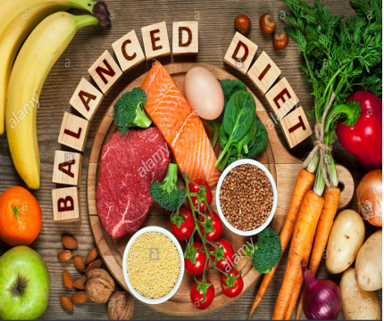
Food And Nutrition
Food - Basic need of Human Beings
Food is necessary not just to satisfy the hunger but is necessary for sound health
स्वास्थ्यासाठी अन्नाची गरज
Importance of Nutritious Diet
Health of individual is related with the type
of diet he/she consumes

Slide 3
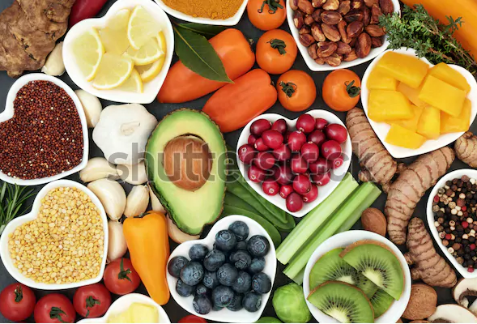
Basic terminology related with science of Nutrition
Food, Nutrition,
Nutrients, Nourishment,
Balanced diet,
Under Nutrition,
Malnutrition
Basic Nutrients-:
1) Carbohydrates
2) Proteins
3) Fats
4) Vitamins
5) Minerals
6) Water

Slide 4
Importance of Food & Nutrition Science for health
Provides knowledge about nutrients
Food supply according to daily recommended allowance
Prevents Malnutrition, Undernutrition
Knowledge of perfect method of cooking
Maintains good physical and mental health
Nourishment to body

Slide 5
Functions of Food
1) Physiological Functions-:
a) Energy
b)Body Building & Growth
c) Repair and maintenance
d)Protection
e) Regulation
2) Psychological Function
3) Social Function
4) Cultural Function
4) Spiritual Function

Slide 6
Diet & Health
Health – A state of physical, mental & social welbeing of an individual and not merely absence of disease.
Characterstics of healthy person -:
Is free from sickness and disease
Is free from social and mental stress
Shows no unnecessary anxiety
Has self confidence
Has organs and organ system which are healthy and function properly
“To keep you in sound health, nutrients in required proportion are necessary”

Slide 7
Thanks

