Slide 1
Name of Topic-Health
Matoshree Vimalabai Deshmukh Mahavidyalaya, Amravati.
Class B.Sc.III.Sem.V
Subject:-Health Hygiene And Microbiology.
Presented by -Dr.K.E.Chaudhary
Professor
Department of Home Science-Biology
I)Defination of Health.II)Diterminants of Health
II)Indicators of Health.
Health is a state of physical, mental and
social well-being in which disease and
infirmity are absent.

Slide 2
I)Definition of health
Health is a state of physical, mental and social well-being in which disease and infirmity are absent.
II)Diterminants of health
III)Indicators of health

Slide 3
Determinents of health-1-Heredity 2.- Environment- 3-Life Style 4-Socio economic conditions
1)-Biology and Genetics
Some biological and genetic factors affect specific populations more than others. Examples of biological and genetic determinants of health include age, sex, inherited conditions and genetic make-up. 2)The conditions of the environment in which people are born, live, learn, play, work and age. Also known as social determinants of health, they impact a wide range of health, functioning and quality-of-life outcomes.
3)lifestyle-Individual behaviors such as diet, physical activity, alcohol, tobacco and other drug use also play a role in health outcomes.

Slide 4
4)Life style and socio economic conditions
Availability of resources to meet daily needs, such as educational and job opportunities, living wages or healthful foods
Social norms and attitudes such as discrimination
Exposure to crime, violence and social disorder
Social support and social interactions
Socioeconomic conditions such as concentrated poverty
Quality schools
Transportation options
Urbanisation and the built environment such as buildings or transportation
Worksites, schools and recreational settings

Slide 5
Determinants of Health The range of personal, social, economic and environmental factors that influence health status are known as determinants of health. These can be classified as: the social and economic environment, the physical environment, the person’s individual characteristics and behaviours. There are many commonly accepted determinants of health but there is no single definition. The Office of Disease Prevention and Health Promotion (ODPHP) has broadly categorised the determinants of health^{[2]} and these have been summarised below: Policy-making Policies at the local, state and federal level affect individual and population health. Increasing taxes on tobacco sales, for example, can improve population health by reducing the number of people using tobacco products. Social Factors Social and physical determinants of health reflect the conditions of the environment in which people are born, live, learn, play, work and age. Also known as social determinants of health, they impact a wide range of health, functioning and quality-of-life outcomes. Examples include:

Slide 6
Examples of Social Determinants
Availability of resources to meet daily needs, such as educational and job opportunities, living wages or healthful foods Social norms and attitudes such as discrimination ,Exposure to crime, violence and social disorder ,Social support and social interactions Socioeconomic conditions such as concentrated poverty Quality schools -Transportation options Urbanisation and the built environment such as buildings or transportation,Worksites, schools and recreational settings

Slide 7
Health Services Both access to health services and the quality of health services can impact health. Barriers to accessing health services include lack of availability, high cost, lack of insurance coverage and limited language access. These barriers to accessing health services lead to unmet health needs, delays in receiving appropriate care, inability to get preventive services as well as hospitalizations that could have been prevented. Individual Behaviour Individual behaviors such as diet, physical activity, alcohol, tobacco and other drug use also play a role in health outcomes. Biology and Genetics Some biological and genetic factors affect specific populations more than others. Examples of biological and genetic determinants of health include age, sex, inherited conditions and genetic make-up.

Slide 9
Health Indicators
Health indicators are quantifiable characteristics of a population which
researchers use as supporting evidence for describing the health of a population.
Typically, researchers will use a survey methodology to gather information about certain people, use statistics in an attempt
to generalize the information collected to the entire population, and then use the statistical analysis to make a statement
about the health of the population.
Health indicators are often used by governments to guide health care policy.

Slide 10
Life expectancy may be one of many example of a health indicator is life expectancy. A government might
have a system for collecting information on each citizen's age at the time of death.
This data about age at death can be used to support statements about the national life expectancy, in which case life expectancy would be a "health indicator"
Applications
Health indicators are commonly used to guide public health policy
A health indicator which will be usedinternationally to describe global health
should have the following characteristics:
It should be defined in such a waythat it can be measured uniformly internationally.
2 . It must have statistical validity.
3. The indicator must be data which can feasibly be collected.
4. The analysis of the data must result in a recommendation on whichpeople can make changes to improve
health
List of health indicators.
Health indicators are required in order to
measure the health status of people and
communities.

Slide 11
List of health indicators.
Health indicators are required in order to measure the health status of people and communities.
Health Indicators
Crude death rate
Life expectancy
Infant mortality rate
Maternal mortality rate
Proportional mortality rate
Morbidity indicators- Prevalence,Incidence,Others
Health status-;Incidence counts of any of the following in a population may be health indicators:^{[3]}
Low birth weight,ObesityArthritisDiabetesAsthmaHigh blood pressureCancer incidenceChronic pain
Oral health,Depression
hospital visits due to injury,reports of waterborne diseases or foodborne illness
Disability indicators:-Disability adjusted life years (DALY)
Others: Activities of daily living (ADL), Musculoskeletal disability (MSD) score etc.

Slide 15
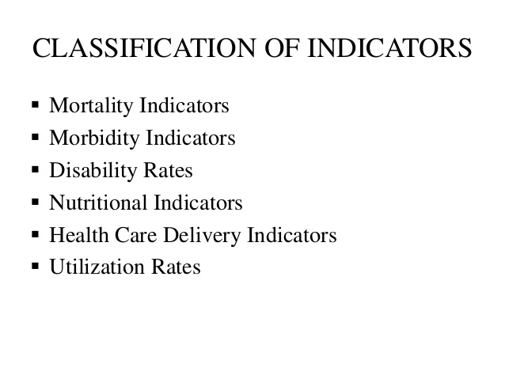
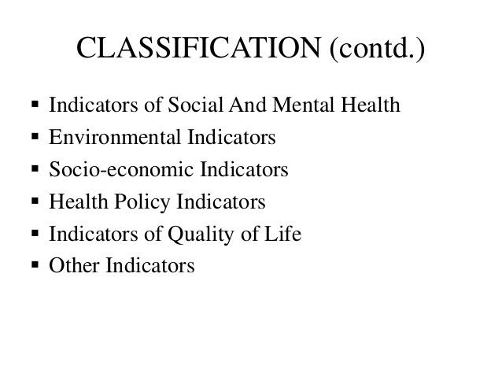

Slide 21
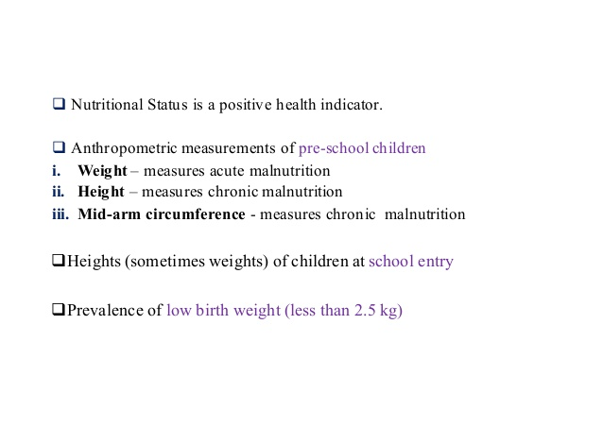

Slide 22
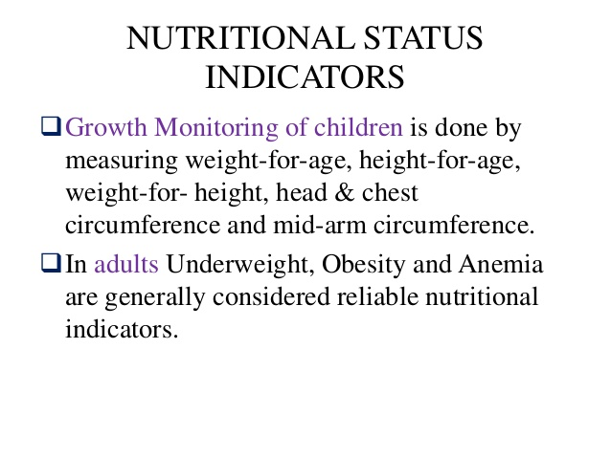

Slide 25
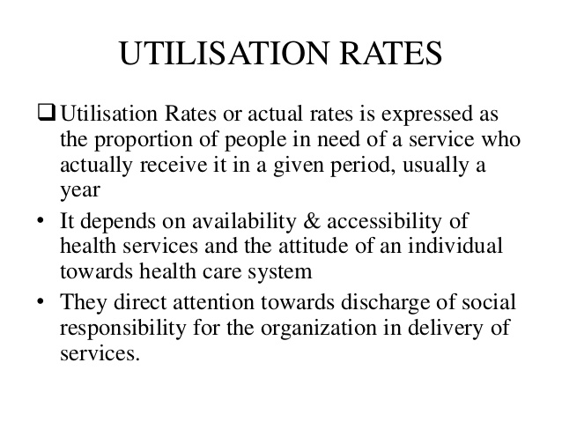

Slide 26
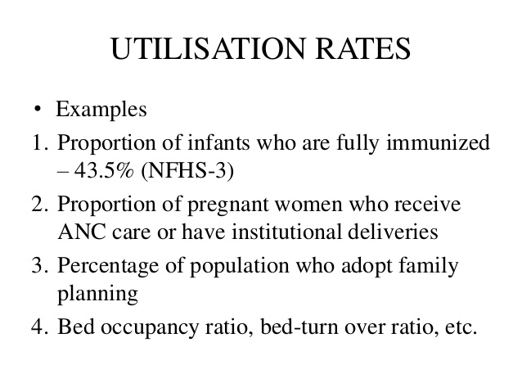

Slide 29
